Slide 1

Swift Clean
# The effortless path
to a spotless home.

Slide 2

FLAT MOP
Mission Statement:
Design user-friendly flat mops with innovative features for effortless, sustainable cleaning.
Vision Statement:
To empower a future of effortless, sustainable cleaning through innovative mop technology.

Slide 3

Motivation
Reduced Strain and Effort
More Efficient Cleaning
Improved Cleaning Reach
Versatility

Slide 4
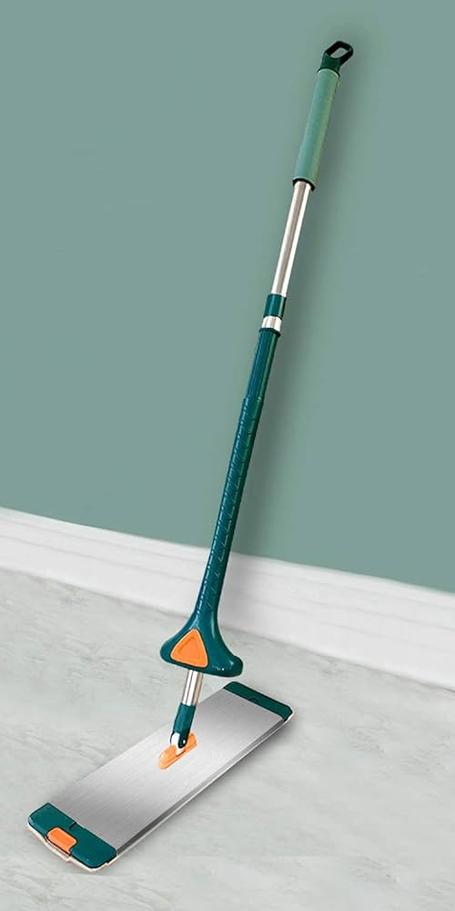
Product Description:
Cap with grip
Top Rod
Base Rod
Slider Squeezer
Ball and socket
Micro fibre cloth
Mop head

Slide 5

Market Analysis
Market Opportunity:
The global cleaning mop market is expected to reach USD 8.2 billion by 2027, growing at a CAGR of 4.8%.
Focus on eco-friendly cleaning products presents an opportunity for mops with sustainable features.
Target Market:
Busy professionals and homeowners who value convenience and time-saving cleaning solutions.
Eco-conscious consumers who are looking for sustainable cleaning products.
People with mobility limitations who may find traditional mops difficult to use.

Slide 6
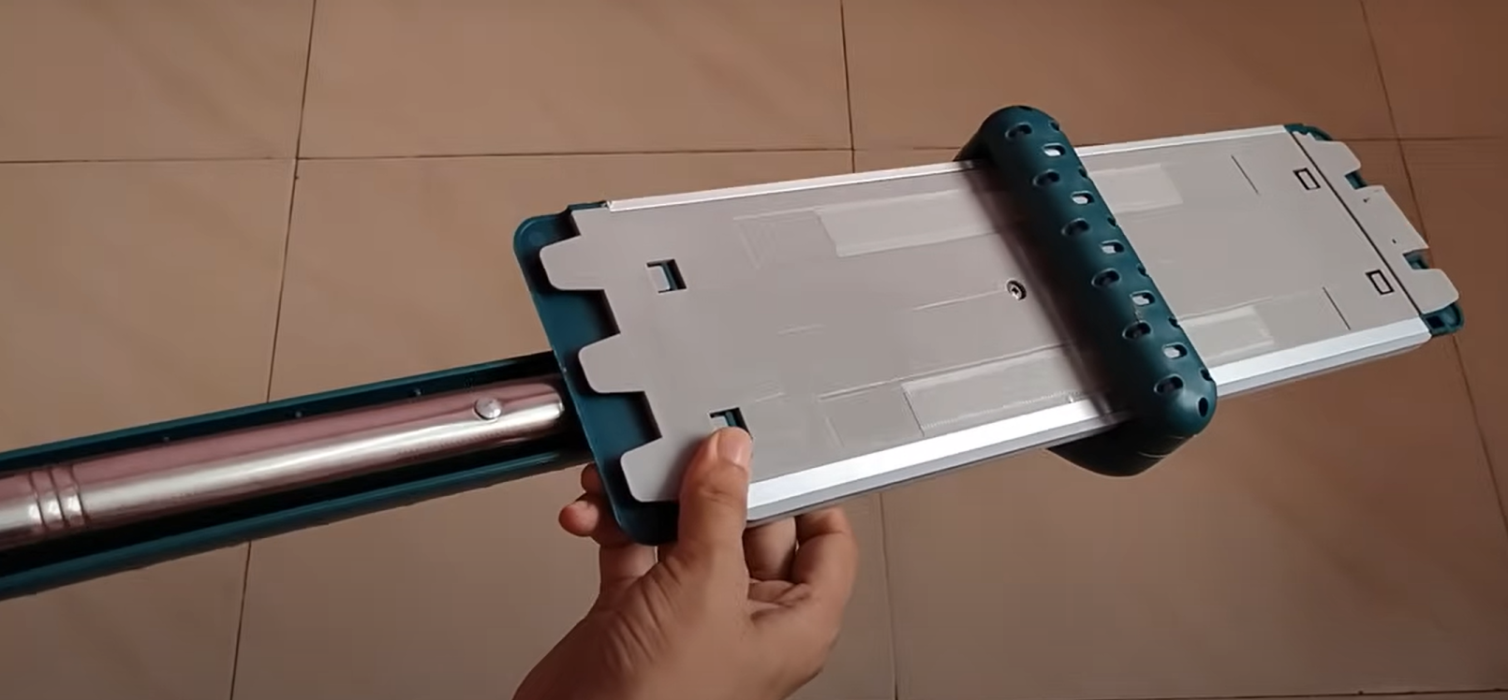
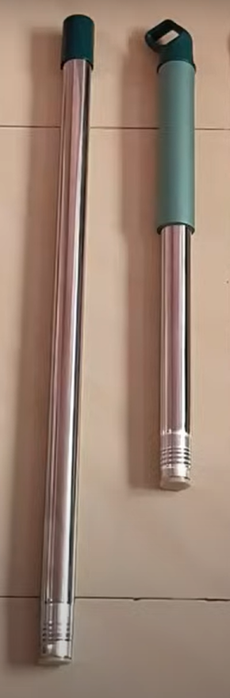
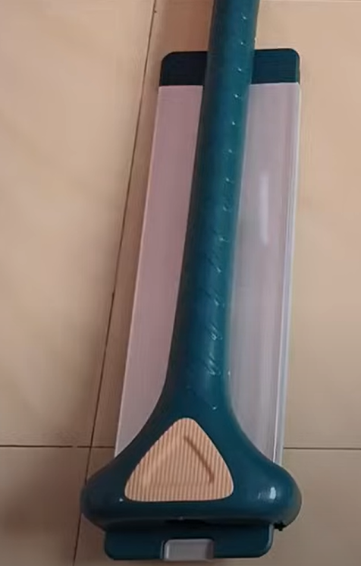
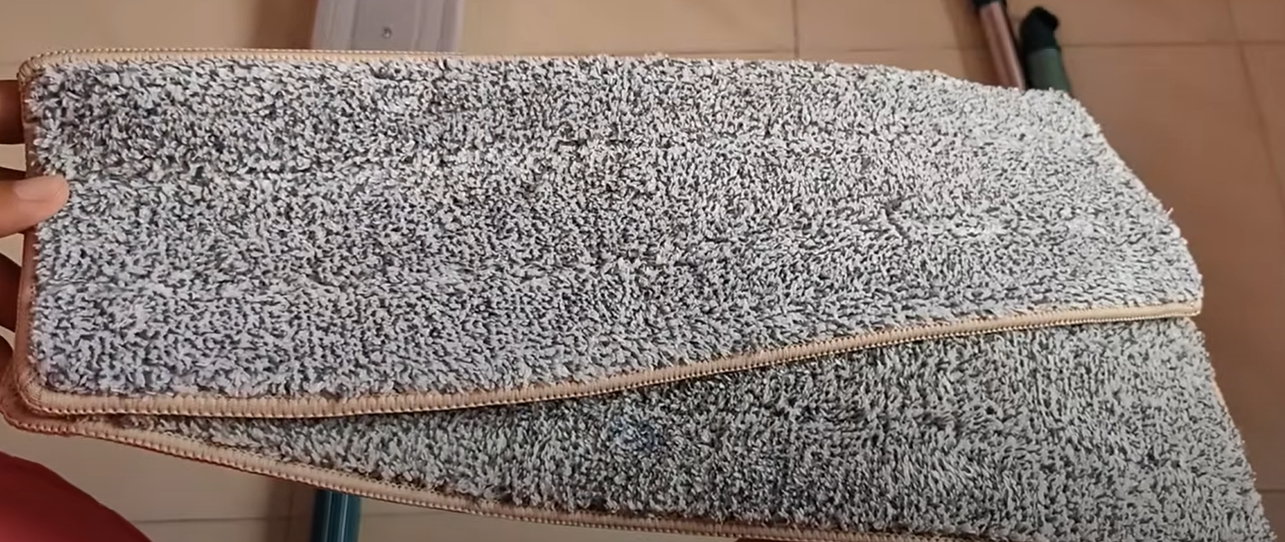
Product Differentiation:
Bucket-less design Sustainable features
Microfibre Mop

Slide 7

Strengths:
Innovation
Enhanced Cleaning Power
User-friendliness
Ease of Use
Sustainability
SWOT Analysis
Weaknesses:
New Product
Learning Curve
Durability Concerns
Refill Costs
Limited Cleaning Solutions
Opportunities:
Green Cleaning Trend
Multi-Surface Cleaning
Online Marketing
Partnerships
Threats:
Competition
Price Sensitivity
Negative Reviews
Substitute Products

Slide 8
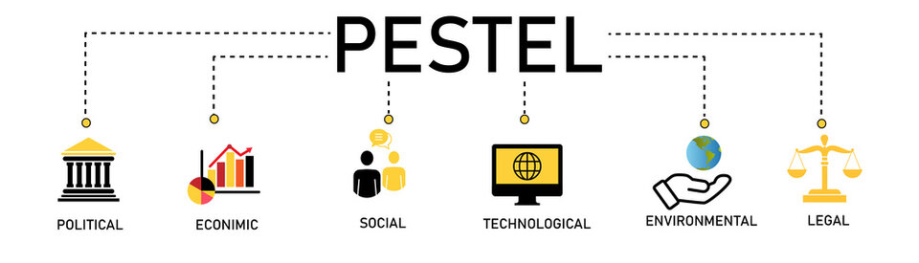
Political:
Government regulations on cleaning products: Regulations on chemical content or disposal of cleaning materials
Environmental policies: Government initiatives promoting sustainability and eco-friendly products.
Economic:
Consumer spending: Economic downturns might lead to price sensitivity,
Raw material costs: Fluctuations in the cost of materials used in the mop
Social:
Growing demand for convenience: The fast-paced lifestyle can increase the appeal of time-saving cleaning solutions like our mop

Slide 9
Technological:
Advancements in cleaning materials: Innovation in microfiber technology
Rise of smart home products: While a potential threat, we could explore integrating smart features (e.g., Automatic optimal cleaning) in future iterations.
Environmental:
Water conservation efforts: The bucket-less design aligns well with water-saving initiatives.
Regulations on plastic use: Restrictions on single-use plastics could impact the mop's design.
Legal:
Product safety regulations: Ensure the mop complies with all safety standards for materials
Intellectual property: If our mop has unique design features, consider patenting them to protect our innovation

Slide 10
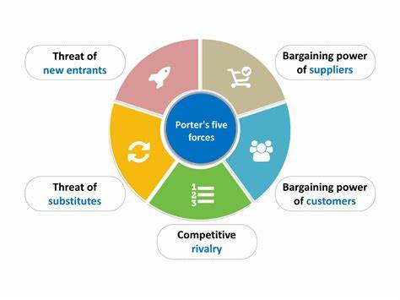
Porter's Five Forces Analysis for a Flat Mop with 360° Rotation, Extensible Handle & Attached Wringer
Competitive Rivalry (High)
Threat of New Entrants (Moderate)
Supplier Power (Low to Moderate)
Buyer Power (Moderate)
Threat of Substitutes (Moderate)

Slide 11
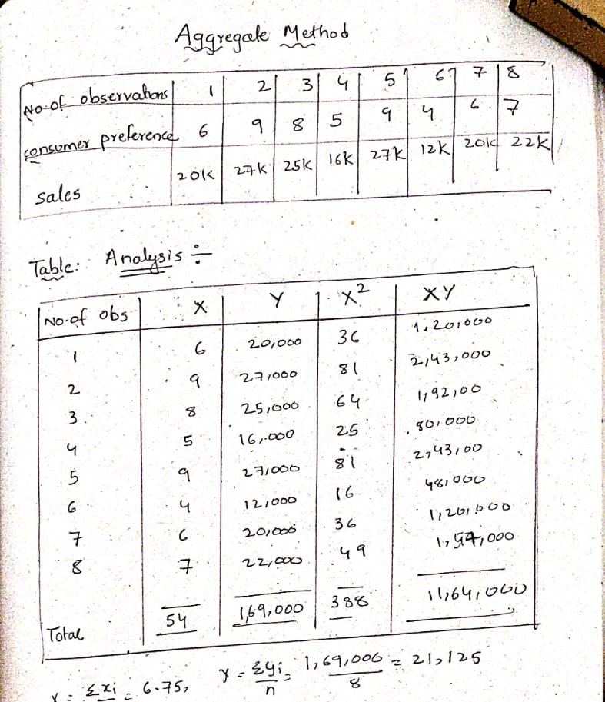
Role of forecasting in supply chain: # Demand forecasts tell MRP what to make (quantity) and when (timing). # Accurate forecasts help MRP optimize inventory levels, saving money and avoiding stockouts. Demand Forecasting using Regression Method

Slide 13
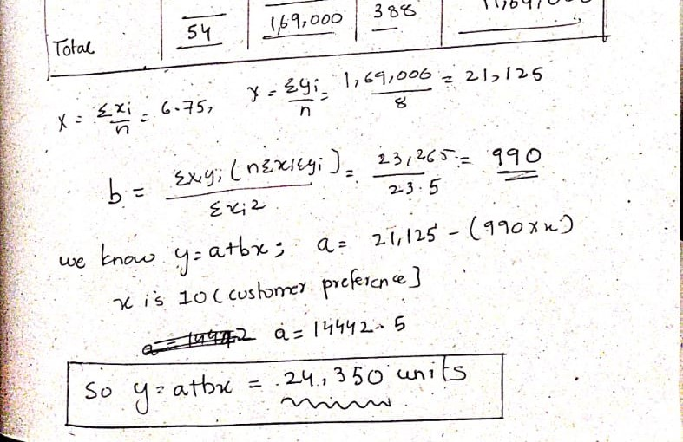

Slide 14
Make or Buy Decision
Stainless steel rod cost:
Material for 6m 200 Rs. So for 1.5m (our required length) is 24350*1.5=36525*200/6 = 12,17,500 Rs
Shipping Cost : 5 Rs per unit. So total shipping cost is 1,21,750 Rs
Total ROD cost is 12,17,500 + 1,21,750 = 13,39,250 Rs and cost per unit is 55 Rs
HDPE Material:
Material for 3items is 10Rs.
So for our demand : 24350*10 = 2,43,500 Rs
Shipping Cost : 0.5 Rs per unit. So total shipping cost is 48,700Rs
Total HDPE cost is 2,92,200

Slide 15
Base rod with hole drilled at end on both sides and threading on top Handle will threading at one end and One nut and Bolt.
MAKE:
Machine Cost: Lathe machine: 3.5 lakh
Holding costs : 5000+15000+100000+2250
= 1,50,000 Rs
Operator cost: 300,000 + 200000
Total Cost : 10,00,000 Rs
Cost per item is 60Rs per unit
BUY:
Material Cost : 50Rs
operation and shipping cost is 50Rs
Total Cost = 100 * 24350 = 2435000 Rs
For Bolt and Nuts: ( Each cost 15Rs)
Buying : 15*24350 = 365000
Total = 28,00000 Rs.
We are going to MAKE these products

Slide 16
Ball and socket:
Buy:
Cost per item is 140Rs
Shipping charges is 10 Rs
Total cost = 150 * 24350 = 36,52,500 Rs
Make:
Material cost : 100Rs ; 50 * 24350= 24,34,000
Machine cost : 12,00,000 Is lathe
Operating and holding costs:7.2 lakhs
Total is 43 lakhs
We are going to BUY

Slide 17
Mop head two mounts on the top with hole in each and three jaws on both sides and Rubber Grip for handle along with cap and Slider squeezer set up.
Buy:
Unit cost: 90 for 3 items
Shipping Charges 10 Rs
Total = 100 * 24,350 = 24,35,000 Rs.
Make:
Machine cost = 7 lakhs
Operator cost = 12*15,000 = 1,80,000
Material cost (HDPE) = 10 Rs for 3 items
So for 24,350 = 2,43,500 Rs
Holding costs = maintenance cost + electric bills etc.. = 2 lakhs
Total = 7 + 1.8 + 2 + 2.435 = 14.235 lakhs
We are going to MAKE

Slide 18
Bill of Materials and Process Description
Component | Quantity per Mop and Production used
Base Rod with threadings on one end and hole drilled on other | 1 – Lathe Machine
Mop head two mounts on the top with hole in each and three jaws on both sides | 1 - – Lathe Machine
Micro fibre sheets slots at the end | 1 - Outsourcing
Slider sqeezer set up. | 1 – Injection moulding machine
Rubber Grip for handle along with cap. | 1– Injection moulding machine
One nut and Bolt. | 1 - Outsourcing
Ball and socket joint. | 1 - Outsourcing
Top rod with threadings on one end | 1- Lathe Machine
Total Units required | For 24350 units of demand we need 24350 of each

Slide 19
Component | Total cost for 1 year in Rs | Cost per unit item | MAKE or BUY
Stainless steel rod | 13,30,250 | 55 Rs | BUY
Base rod with hole drilled at end on both sides and threading on top and Handle will threadings at one end | 14,61,000 | 60 Rs | MAKE
Mop head two mounts on the top with hole in each and three jaws on both sides | 13,63,600 | 56 Rs | MAKE
Micro fibre sheets with slots at the end | 31,89,850 | 131Rs | BUY
Rubber Grip for handle along with cap. | 4,38,300 | 18Rs | MAKE
Ball and socket joint. | 36,52,500 | 150 RS | BUY
Slider squeezer set up. | 12,17,500 | 50 Rs | MAKE
Total | 1,26,62,000 in Rs | 520 Rs

Slide 20
Selling Price:
Production cost = 520 Rs per unit
Administration and sales = 10% = 52 Rs per unit
Distribution over heads = 15% = 78 Rs per unit
Direct and Indirect Costs = Total cost of production= 650 Rs
Selling price = cost of production + profit = 650 Rs + 100(profit) = 750 Rs

Slide 21
Break even analysis:
Break Even analysis:
750*x= 550*x + 75,00,000
On calculating we get X as 30,000 units per annum
So If we can only produce 24,350 units per year
Break even Point is
1 year + [(30,000-24,350)/(24,350)]
So It will be taking around 15 Months to reach break even point.
We want to Sell our product at 750 Rs
Fixed cost for the product:
This include Machine cost, salaries etc..
Total of above factors is 70 lakhs
Maintenance cost: 5lakhs
Total fixed Cost is: 75 lakhs.
Variable cost for the product:
This include labour cost , raw material, bonus etc..
Total variable cost is 550 Rs per unit

Slide 22
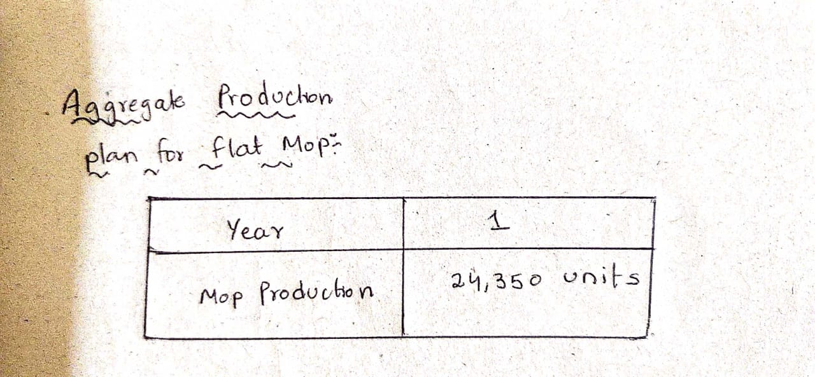
MRP – Materials Requirement Planning

Slide 23
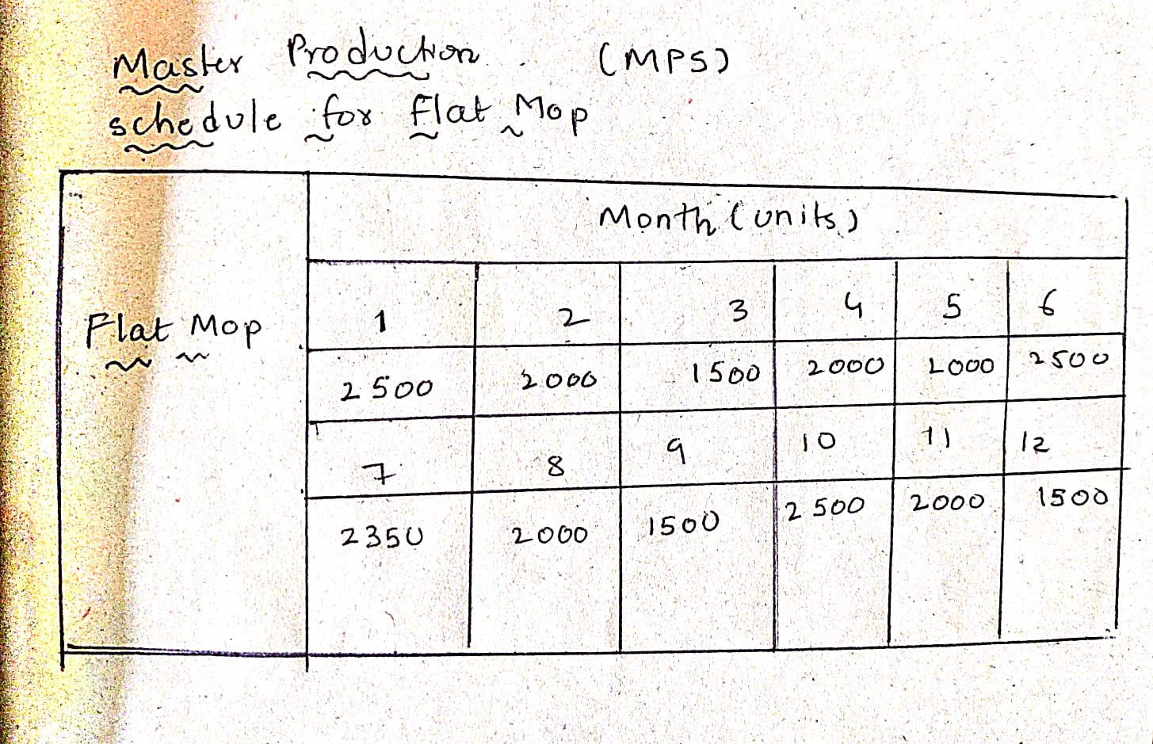
Master Production Schedule

Slide 24
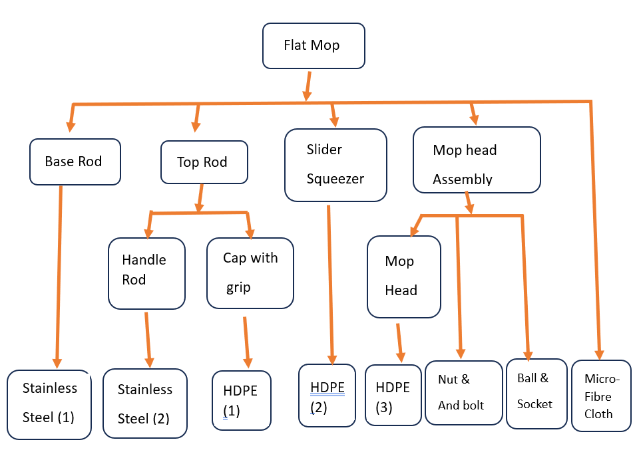
BOM file in Tree structure Format
Level 0
Level 1
Level 2
Level 3

Slide 25
Lead Time for Base Materials
Determine the lead time for each material. This is the time it takes to receive the material after placing an order. Here are some estimates:
Locally sourced plastic (HDPE) components: 2 weeks
Stainless steel : 2 weeks
Microfiber (depending on supplier): 3 weeks

Slide 26
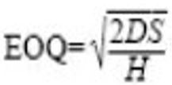
Lot Sizing:
We will go for lot for lot sizing for level 0 , 1 , 2 components and EOQ sizing for level 3 components.
EOQ lot sizing:
Annual Demand is 24350 units
Annual Demand Based on 6 months is 24350/2=12,175 units
Annual Holding cost = 0.5% * 5 Rs * 52weeks = 1.3 Rs per unit
Set up cost is 300Rs per unit.
= [(2*12,175*250)/7.8]^0.5 = 2370.5 units.
Lot for lot sizing:
This is simply ordering the exact amount of required products before lead time.

Slide 27
Mass Production:
Reasons to Choose Mass Production for our Cleaning Mop:
Since we've decided on high-volume production hollow stainless steel tube with turning and drilling and heavy plastic components , here's why mass production is a good fit
Economies of Scale: Mass production spreads fixed costs (equipment, building rent) across a large number of units, bringing down the cost per unit significantly.
Efficiency: Repetitive tasks become streamlined. Workers specialize in specific tasks, allowing them to become highly efficient.
Inventory Management: You can predict demand with more accuracy and optimize inventory levels to reduce holding costs.
Standardization: Consistent quality is maintained because the process is standardized.

Slide 28
Layout:
Assembly Line Layout: Products move on a conveyor belt through various stations where specific tasks are performed. This is ideal for your scenario as the turning, drilling, and other processes can be divided into specialized stations.
Advantages: Efficient, standardized flow, reduces work-in-process inventory.
Disadvantages: Reliant on the line's speed, inflexible for variations, requires good planning to balance tasks at each station.

Slide 29
Assembly Line 1: Stainless Steel Tube Processing
This line cuts 6-meter hollow stainless steel rods into 4 pieces of 1.5 meters each, performs threading on one end of two rods simultaneously, and drills a hole perpendicular to the pipe on one of the rods.
Stations:
Loading Station (10 seconds/tube): Workers load a 6-meter hollow stainless-steel rod onto the conveyor belt.
Cutting Station (15 seconds): A semi-automatic saw cuts the rod into four 1.5-meter lengths.
Buffer Station 1 (20 seconds): Holds cut tubes to accommodate potential downtime at Station 4.
Loading Station 2 (10 seconds): Workers manually load cut tubes into a holding fixture.
Threading Station (80 seconds): A CNC lathe performs threading on one end of both tubes simultaneously.
Buffer Station 2 (20 seconds): Holds threaded tubes before the drilling operation.

Slide 30
Drilling Station (40 seconds): A CNC drilling machine drills a hole perpendicular to the pipe on one of the threaded tubes. The other threaded tube bypasses the drilling station.
Cutting Station (15 seconds): A semi-automatic saw cuts the rod into 0.6 and 0.9 meters.
9. Cleaning Station (10 seconds): An automated process removes debris from the finished tubes.
10. Quality Control Station (20 seconds): Workers inspect and measure the cut lengths, threads, and drilled hole for accuracy.
11. Unloading Station (10 seconds): Workers unload the finished tubes (one drilled, one threaded) from the conveyor belt.
12. Assembling Station (10 seconds): To the handle rod, attach Cap with grip
13. Wrapping Station (20 seconds) : Wrapping machine wraps 2 parts individually
Total Estimated Cycle Time per Unit (including buffer wait times): 280 seconds (or 4.66 minutes)

Slide 31
Line 2: HDPE Plastic Components
This line manufactures plastic components for the mop:
HDPE Feeding Station (10 seconds): Workers load HDPE granules into the machine hopper.
Injection Moulding Machine (140 seconds): A single mould is prepared for all three parts
3. Cooling Station (30 seconds): Plastic parts require cooling after molding. The time here depends on part.
4. Parting Station (10 seconds): Cutting machine cuts three parts and do finishing for each.
5. Quality Control Station (10 seconds/part): Workers inspect the finished plastic parts for defects. (Total 30 seconds)

Slide 32
6. Assembly station(30 seconds) : Flat mop + Ball and socket joint + Bolt and nut + Micro fibre cloth
7. Wrapping Station (20 seconds) : Wrapping machine wraps 2 parts individually
Total Estimated Cycle Time per Unit (excluding buffer wait times): 250 seconds (or 4.33 minutes)
Final assembly:
# Packaging Station (15 seconds): Assemble all the products in a box.
@ For the complete product to be made, it is taking 305 seconds (5.1 min)

Slide 33
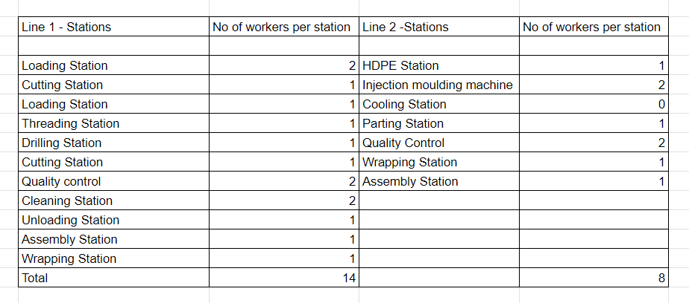
No of workers per station:

Slide 34
Factory Physics:
A pull system only allows a job onto the floor when a signal generated by a change in line status calls for it and pull systems are make-to-stock.
Assumptions:
Production Target: 2030 finished mop units per month
Single-shift operation with 20 working days per month and 8 working hours per day.
1. Takt Time:
Takt Time = (Total Available Production Time) / (Production Target)
Takt Time = (20 days/month * 8 hours/day * 60 minutes/hour) / (2030 units/month) = 4.73 minutes/unit = 284 seconds/unit.

Slide 35
Total Estimated Cycle Time per Tube:
For Line 1:
Loading + Cutting + Buffer 1 + Threading + Buffer 2 + Drilling + Quality Control + Cleaning + Unloading = = 280 seconds/tube
No of Theoretical Stations = 280 seconds/tube / 284seconds/tube = 0.99 (approx)
Since we can't have a fraction of a workstation, we round up to 1 theoretical stations. This is a low number, indicating a potentially simple or short line.
Downtime :
Downtime refers to a period when a system, device, or process is unavailable or inoperable. This can happen for planned reasons or unplanned reasons
We assume downtime percentage to be 0.05% for all stations.

Slide 36
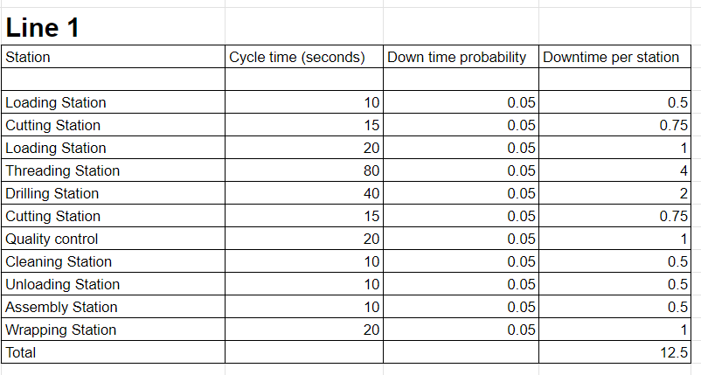
Downtime Calculations:

Slide 37
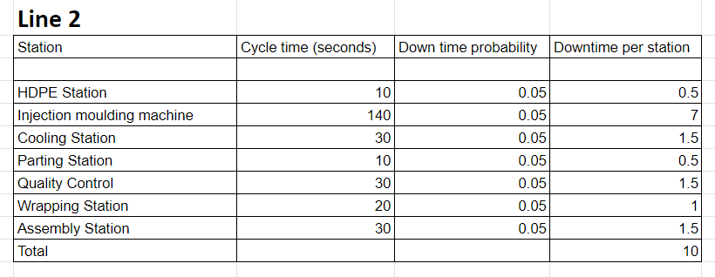

Slide 38
Effective Cycle Time = Cycle time * ( 1+rework rate)
Rework rate refers to the percentage of units that require additional processing or correction after going through a production process.
It is assumed as 0.02
Effective Cycle time = 280 * (1.02) = 285.6 seconds
Practical Capacity = 60min/effective cycle time = 12.6 units/hour
Line efficiency = practical capacity/theoretical capacity = 98%
With a downtime probability of 5% and a buffer size of 1 unit, the buffers can likely absorb most downtime events without impacting production.

Slide 39
Bottle Neck Analysis:
Line 1:
@threading operation = 1/80 units/second = Rb [Least Through Put]
Cycle time = 280 seconds
Optimal WIP = [1/80] *280 = 3.5 units.
Line 2:
@Injection Moulding = 1/140 unit/second = Rb [Least Through Put]
Cycle time (t0) = 250 seconds
Optimal WIP = [1/140] *250 = 1.786 units.

Slide 40
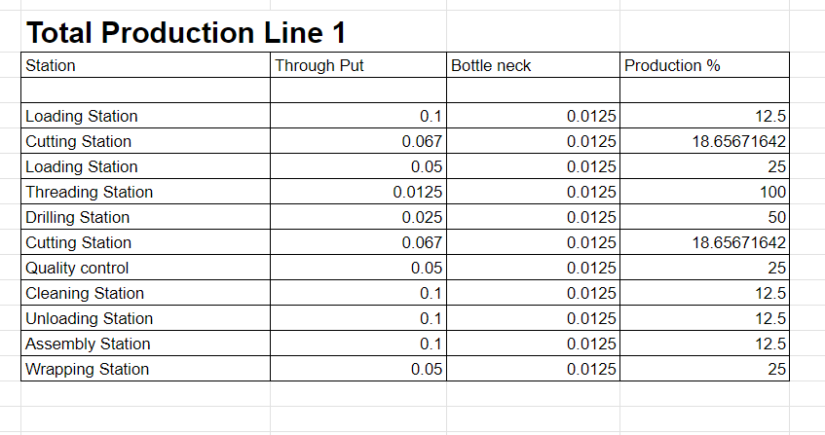

Slide 41
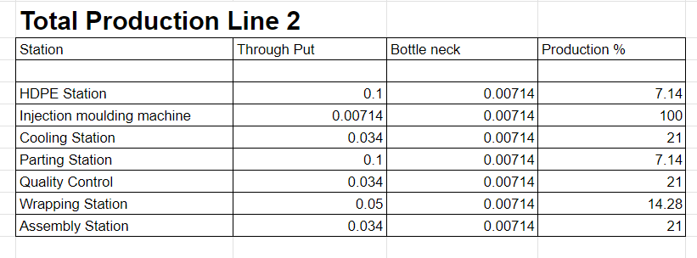

Slide 42
Production Rate Improvement Strategies:
Based on the analysis, here are some potential improvement strategies:
Reduce Threading Time: Explore faster threading techniques or add another threading station.
Reduce Drilling Time: Analyze the drilling process for optimization or consider adding a second drilling station if practical.
Reduce Injection Molding Time: Use more advanced machine or technique.
Minimize Downtime: Implement preventive maintenance programs
and improve repair efficiency to reduce downtime at all stations.
Line Balancing: If feasible, redistribute tasks across stations to create a more balanced workload and potentially eliminate buffer stations.

Slide 43
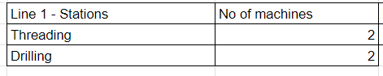
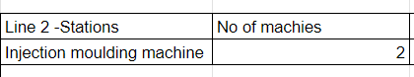
For Bottle neck Reduction

Slide 44
Production Improvement 1:
Line 1:
@threading operation = 2/80 units/second = Rb
Cycle time = 280 seconds
Optimal WIP = [2/80] *280 = 7 units.
Line 2:
@Injection Moulding = 2/140 unit/second = Rb
Cycle time (t0) = 250 seconds
Optimal WIP = [2/140] *250 = 3.572 units.
Through Put = Money

Slide 45


Scheduling
Forward scheduling is a task management approach that prioritizes completing tasks as soon as possible. In this method, you plan your work to start and finish at the earliest opportunity, aiming to beat deadlines and create buffer time
.
Critical Path Method (CPM): Identify the critical path, which determines the longest sequence of tasks and helps prioritize activities to minimize overall project duration.

Slide 46
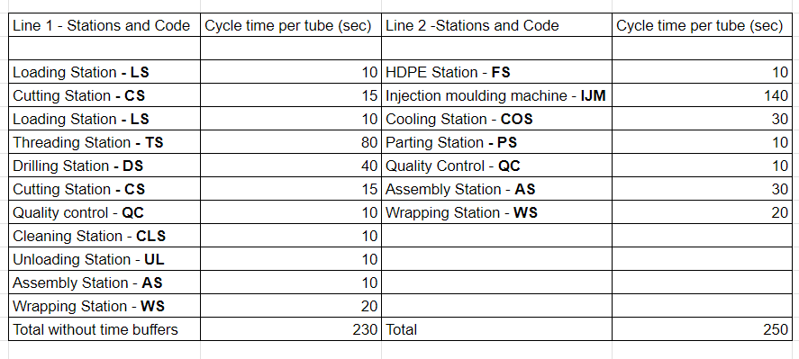
Cycle time of each station and Code:

Slide 47
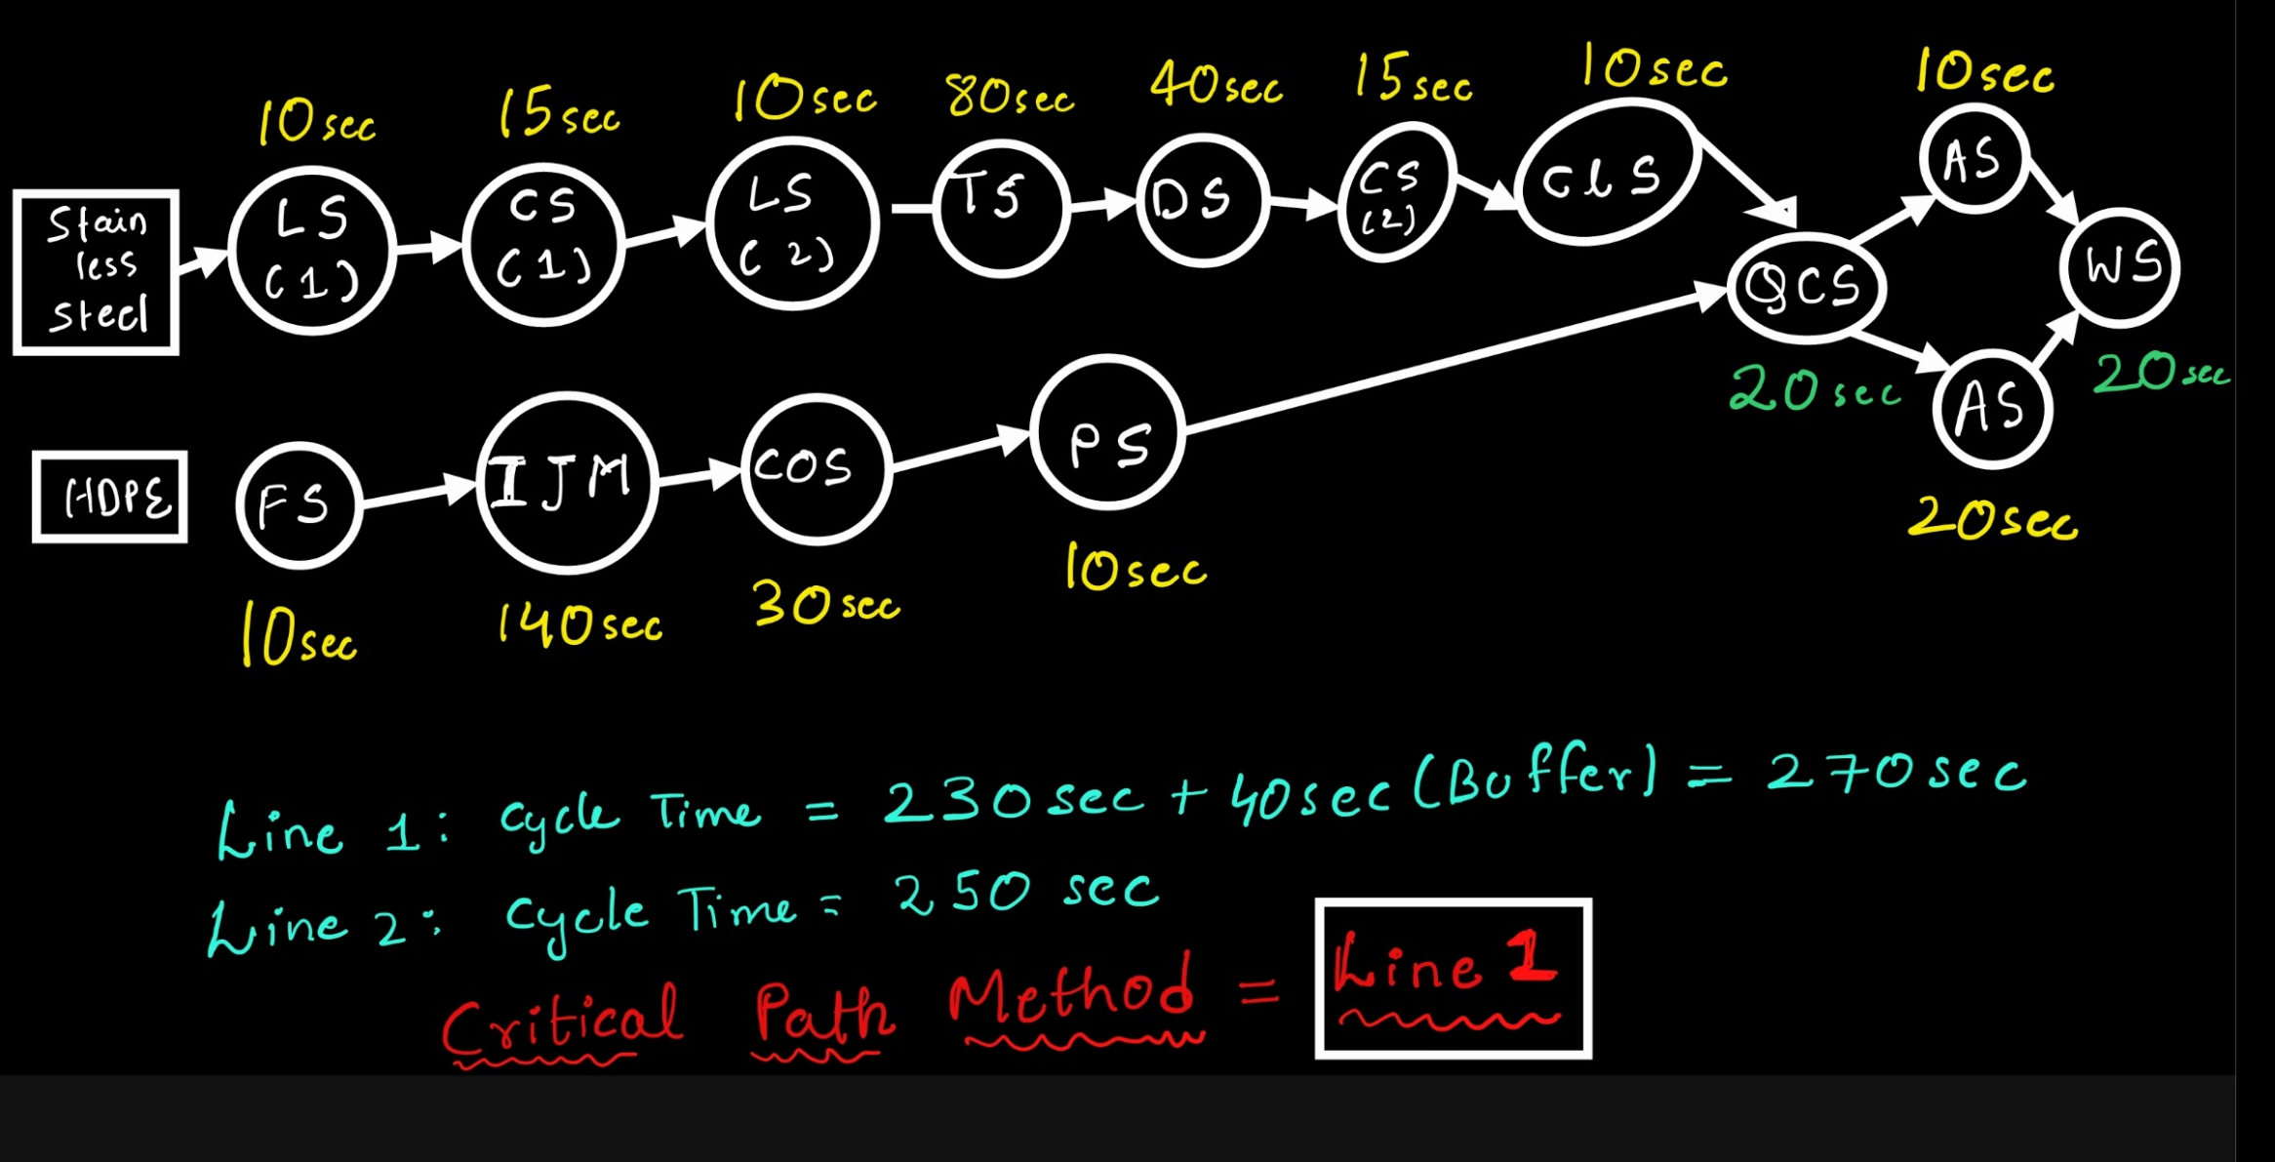
Precedence Diagram:

Slide 48

Production Improvement 2:
As line 1 is Critical Path we can focus more on this line:
This line won’t have unpanned breakdowns
Workers efficiency should be High in this line
Material flow Should surplus.
As line 2 have some idle time 30 seconds with this we can provide extra workforce to the line 1 in this 30 seconds which will be helping the Drilling process.
With this we can decrease the cycle time which Improves Productivity

Slide 49

Thankyou

